Slide 1

The International Conference on Automation, Control and Mechatronics for Industry 4.0 (ACMI 2021)
Utilizing IPFS and Private Blockchain to Secure
Forensic Information
Paper ID: 122
Authors:
Saha Reno
Shovan Bhowmik
Mamun Ahmed

Slide 2

Outline
Introduction
Motivation
Objective
Related Research
Methodology
Result Analysis
Conclusion
Future Research Direction
References

Slide 3
Introduction
Forensic Science includes scientific methods to find out the actual cause of a crime and to bring justice to the victims.
Forensic documents are confidential in the sense that any alteration of information here will make a huge difference in finding the original cause of the incident and suspected persons.
These details are considered as extremely valuable and confidential as it helps the law enforcement agencies and prosecutors to ensure punishment to the blameworthy persons.

Slide 4
Motivation
Forensic reports require security only to restrict access to the authorized person.
Till now these documents are not stored electronically in a secured place.
Information can be easily accessed by intruders who have ill motives to destroy further investigations.
Blockchain can be a solution to secure those data so that no outsiders except the concerned persons can get that information.

Slide 5
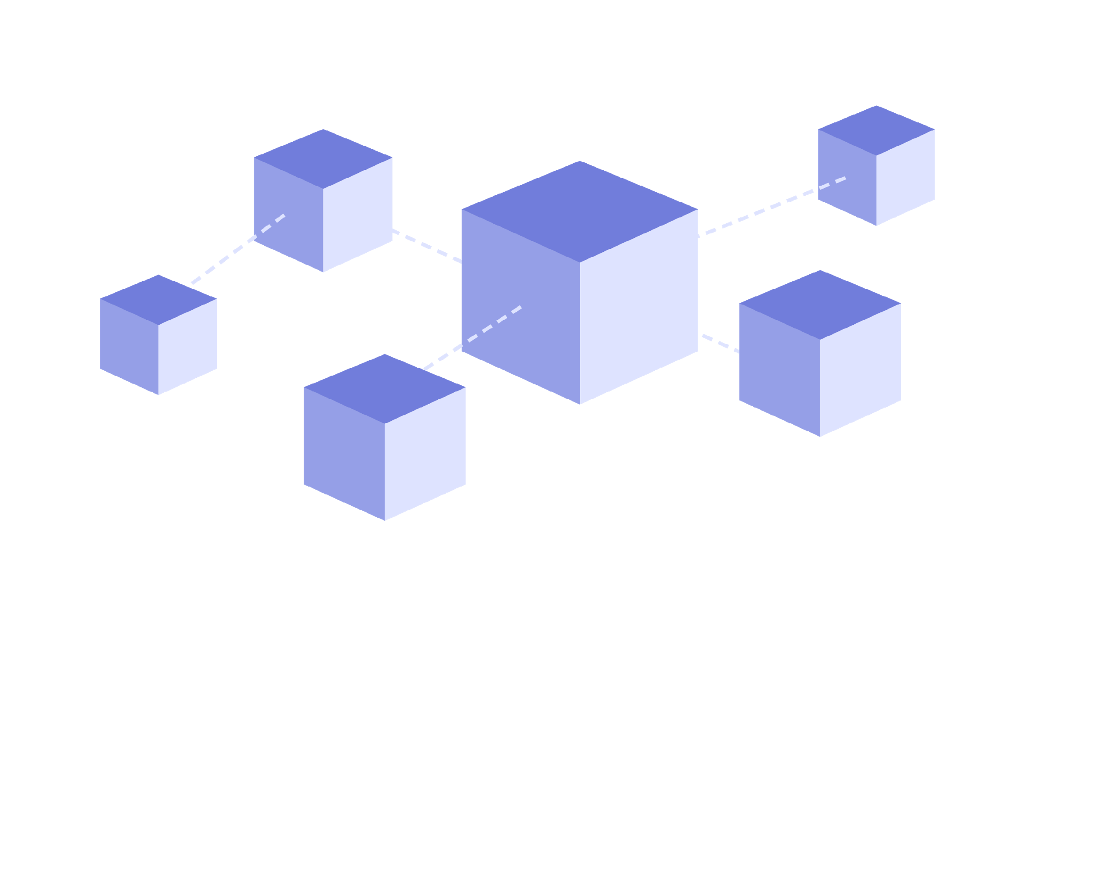
Objective
Assembling Inter-Planetary File System (IPFS) and Hyperledger based private blockchain to implement a secure forensic information storing system.
Enabling the tracing of any illegitimate entrance or data tempering by the intruders.
Surpassing the classical public blockchain systems i.e. Bitcoin and Ethereum in terms of transaction processing time

Slide 6
Related Research
Author | Work | Limitation
Akib et el.[2018] | - Comprehensive view of transactions for security, legality, authentication and validation of forensic data was introduced - Demonstrated a digital forensic chain of custody | Publicly Accessible Does not preserve Organization privacy
Singh et el.[2016] | - Proposed IoT enabled Device to provide safety to multiple chains of records from cyber-attacks | A small amount of data can be assembled using the aforementioned framework No Hyperledger usage
Filippo [2018] | - devised a management model based on blockchain for analyzing mass crisis scenarios from electronic health records | IPFS was not introduced consists of convoluted sections and lacks particular assets
Our Proposed Model | - allows the user to accommodate both textual and media files - The private and permissioned nature of our blockchain allows the controlling of access to the analytical report - faster transaction execution by using Hybrid model

Slide 7
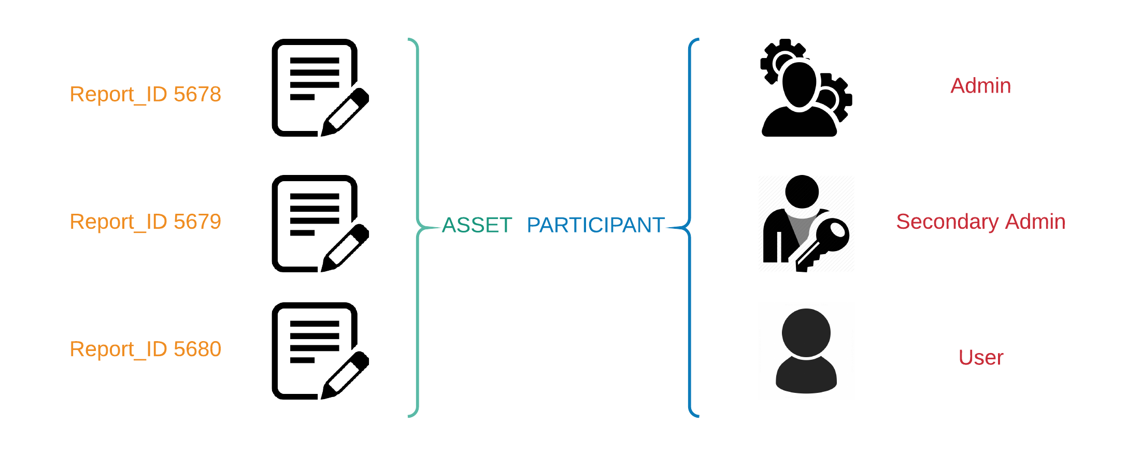
Methodology

Slide 8
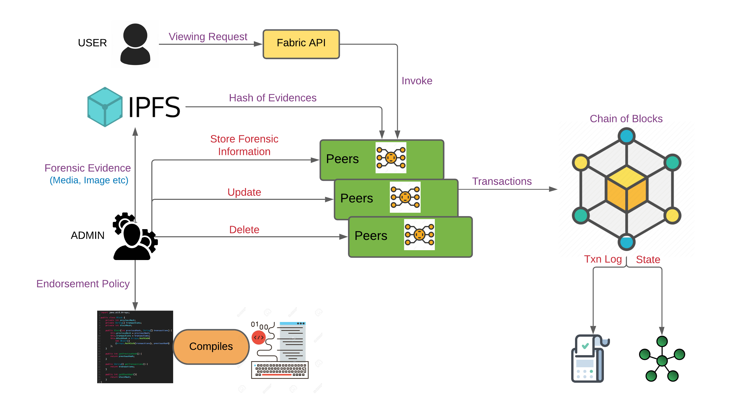
Methodology

Slide 9
Methodology
Generation of Assets
Submitting Transactions
Utilizing IPFS to Store Media Type Forensic Evidences
Issuing Identities to the System Participants
Manipulating Asset Registry for Placement of Assets
Querying Transactions Inside Historian Records
Setting the Parameters of Access Control Feature

Slide 10
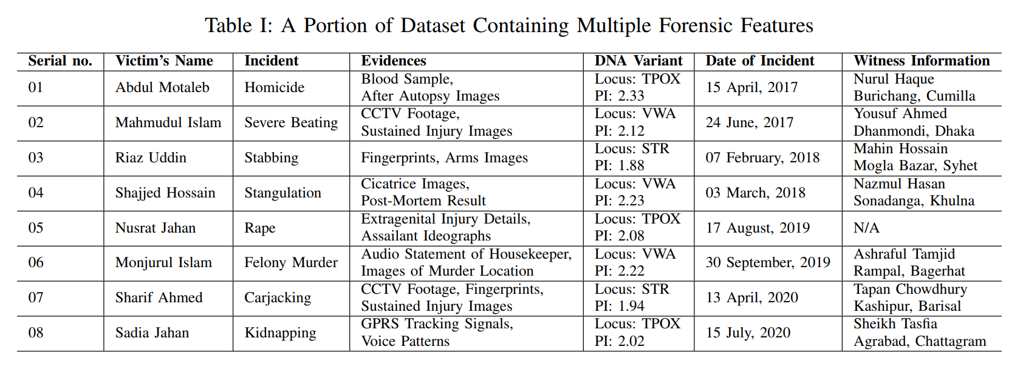
Result Analysis

Slide 11
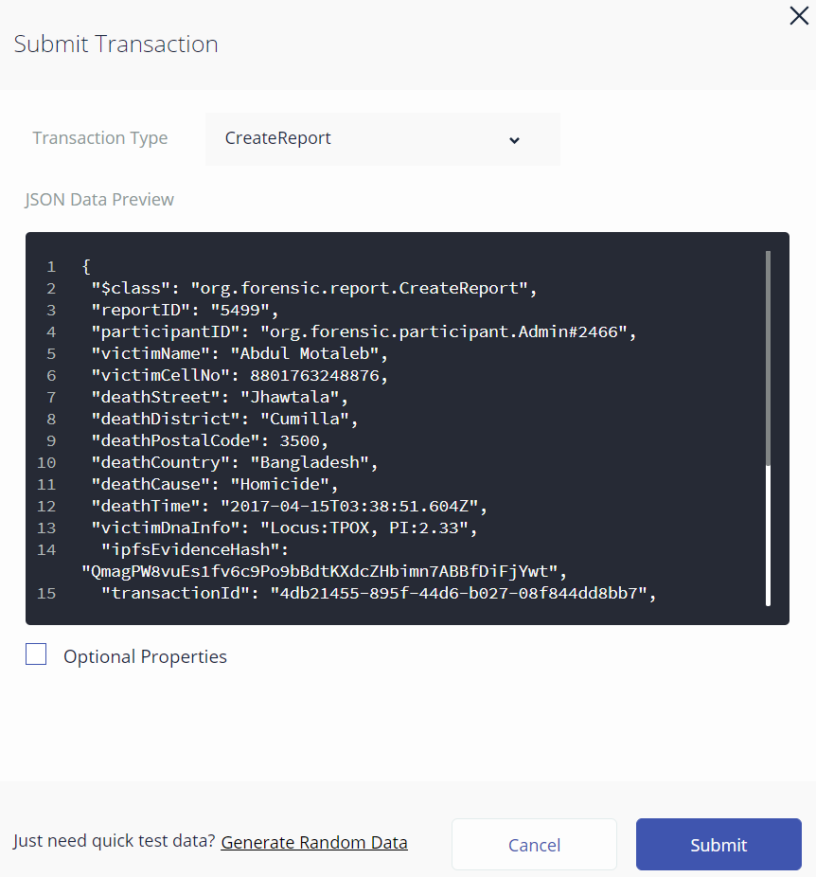
Result Analysis

Slide 12
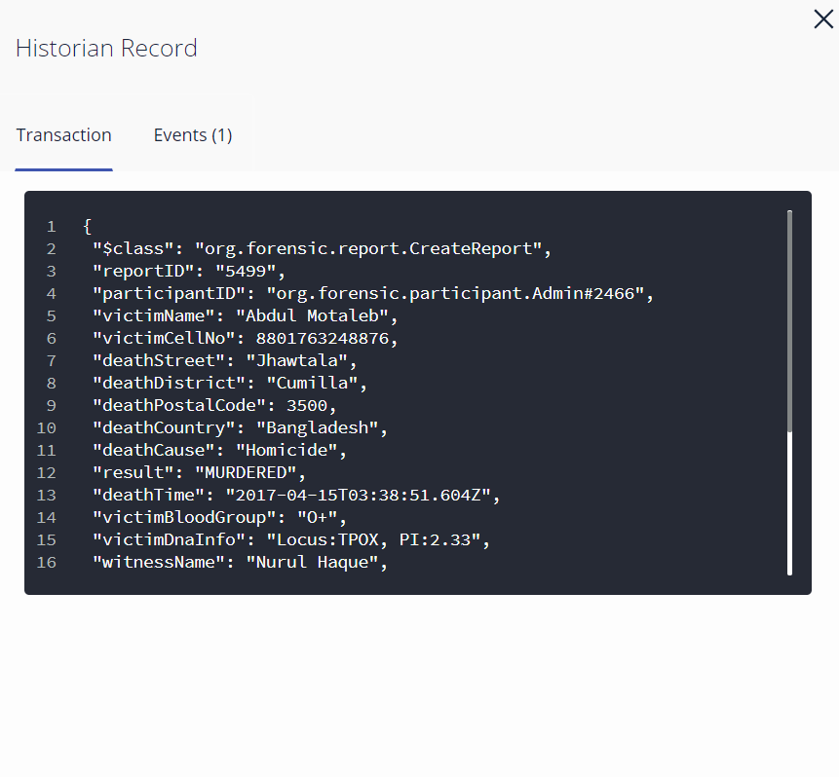
Result Analysis

Slide 13
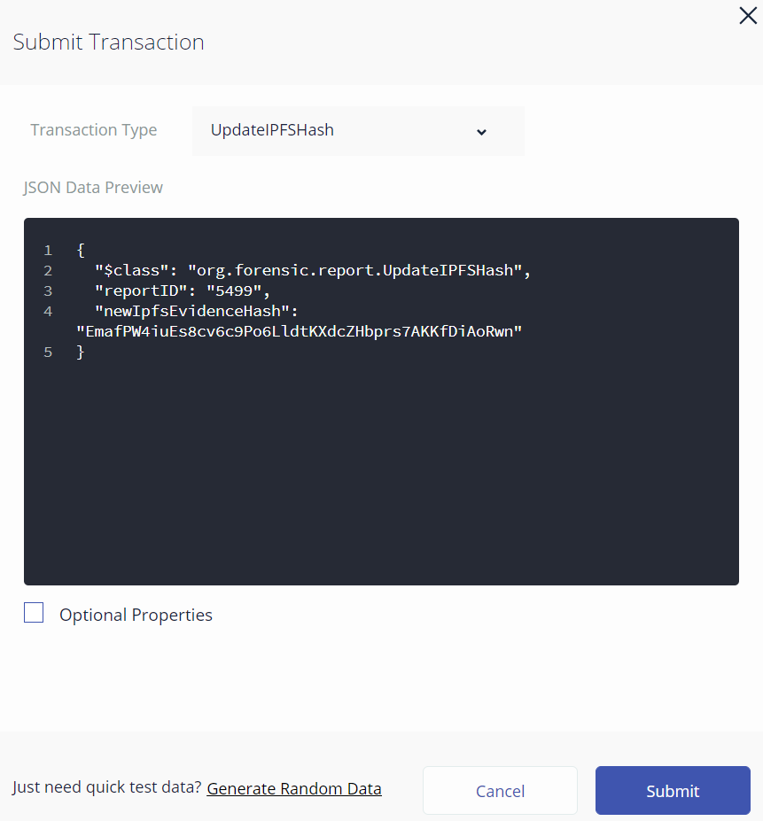
Result Analysis

Slide 14
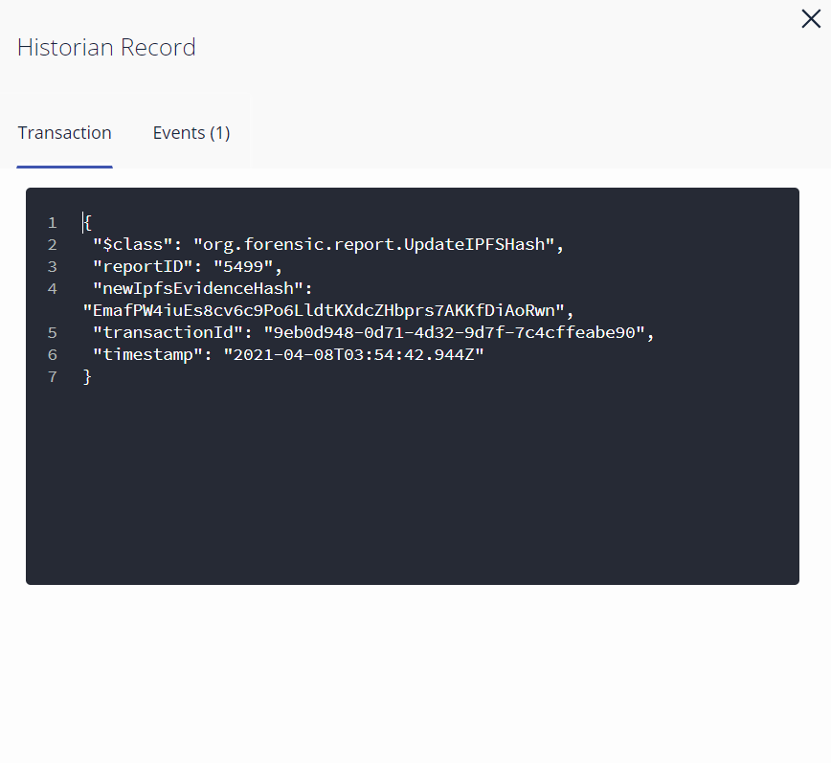
Result Analysis

Slide 15
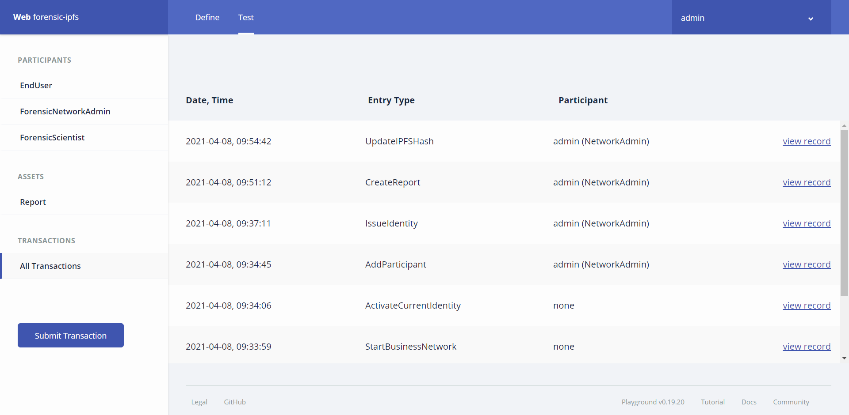
Result Analysis

Slide 16
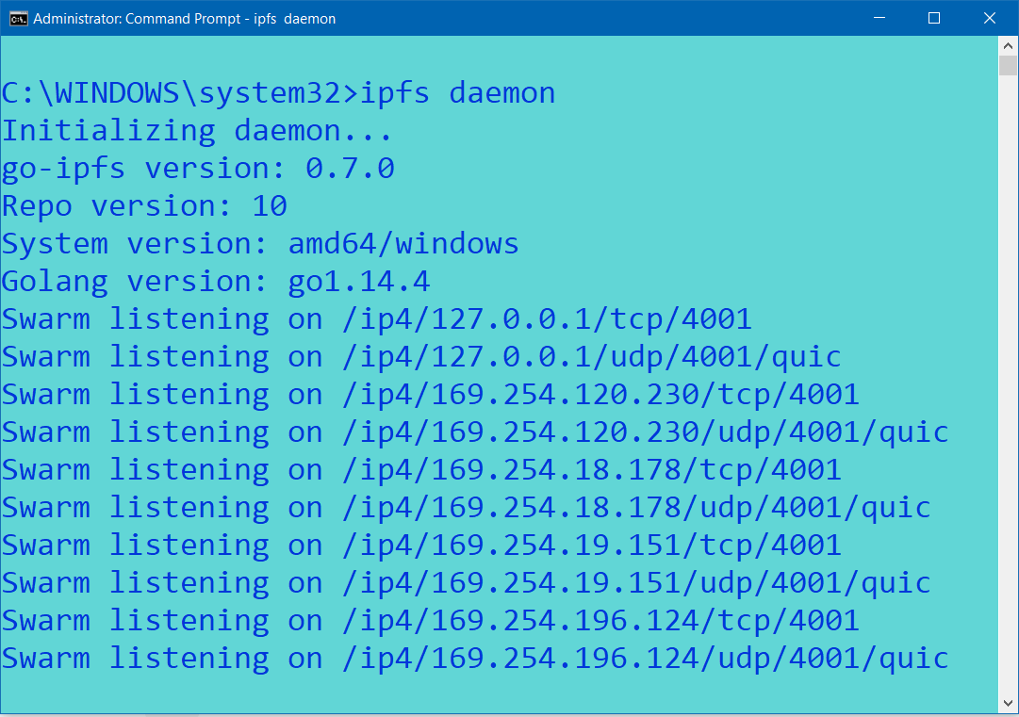
Result Analysis

Slide 17
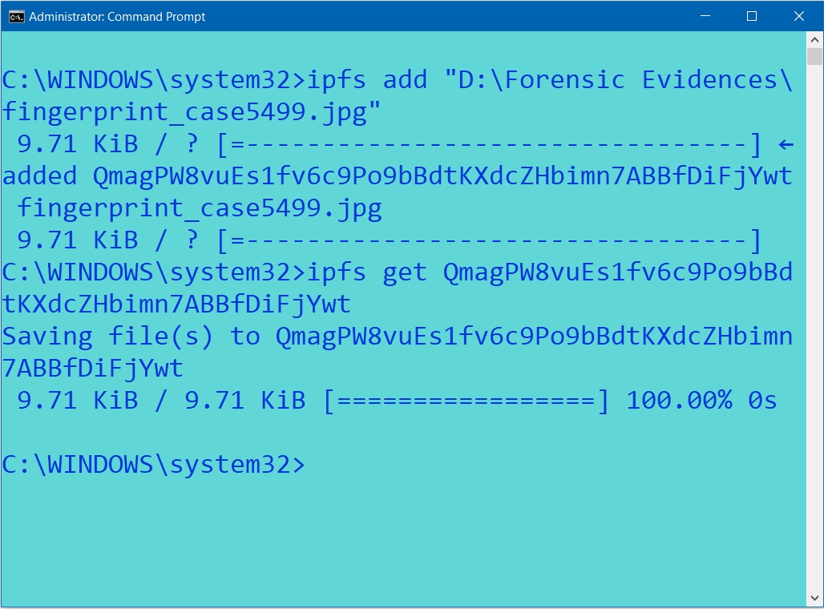
Result Analysis

Slide 18
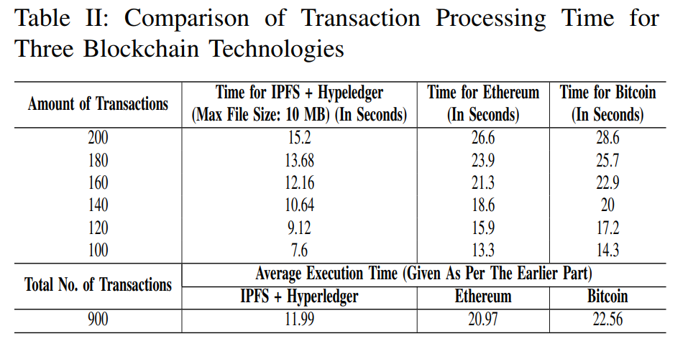
Result Analysis

Slide 19
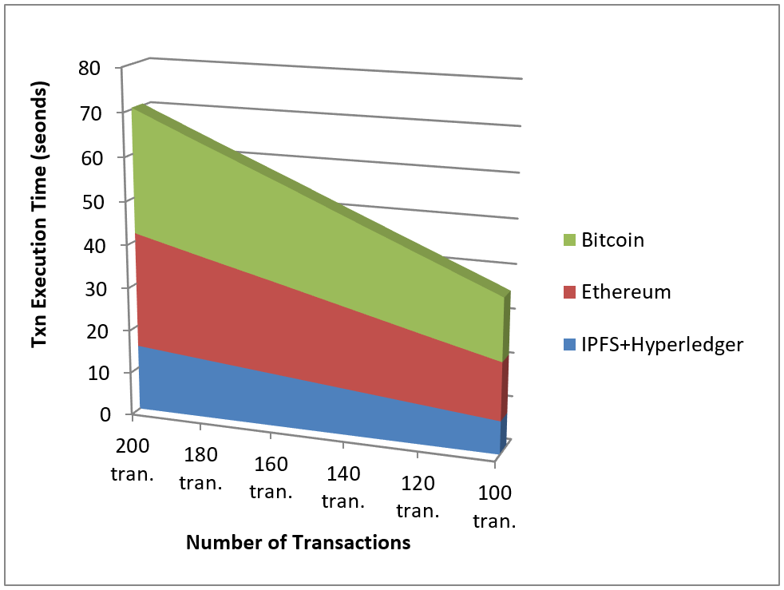
Result Analysis

Slide 20
Conclusion
The permissioned and private nature of our proposed system has made the forensic analysis system much more secure and reliable than the existing public and permissionless blockchain-based platforms.
Our Hyperledger-based forensic analysis framework overcomes the limitations of requiring cryptocurrency to execute any transaction, storage bloating issue and public accessibility.
Faster transaction processing time and availability of the space for uploading and retrieving media files outclasses other existing blockchain-based forensic information storing systems.

Slide 21
Future Research Direction
However, our system does not support parallel processing which can minimize the execution time.
In future, Hyperledger Sawtooth can be used to overcome this limitation.

Slide 22
References
[1] M. McCall, “How to Write a Forensic Report,” Legal Beagle, January 13, 2019, Available: https://legalbeagle.com/5858380-write-forensicreport.html
[2] L. Conway, “Blockchain Explained,” Investopedia, Nov 17, 2020, Available: https://www.investopedia.com/terms/b/blockchain.asp
[3] S. Nakamoto, “Bitcoin: A Peer-to-Peer Electronic Cash System,” Manubot, Nov 20, 2019.
[4] V. Buterin, “Ethereum: A next-generation smart contract and decentralized application platform,” URL https://github.com/ethereum/wiki/wiki/% 5BEnglish% 5D-White-Paper, Dec 7,
2014.
[5] M. Stefanovic, D. Pruzlj and D. Stefanovic, “Blockchain and Land Administration: Possible applications and limitations,” International Scientific Conference on Contemporary Issues in Economics, Business and Management, 2018.
[6] S. Singh and N. Singh, “Blockchain: Future of financial and cyber security,” 2016 2nd International Conference on Contemporary Computing and Informatics (IC3I), Greater Noida, India, 2016, pp. 463-467, doi: 10.1109/IC3I.2016.7918009.
[7] A. H. Lone and R. N. Mir, “Forensic-chain: Ethereum blockchain based digital forensics chain of custody,” Scientific and Practical Cyber Security Journal, vol. 1, no. 2, pp. 21-27, 2018
[8] A. H. Lone and R. N. Mir, “Forensic-chain: Blockchain based digital forensics chain of custody with PoC in Hyperledger Composer,” Digital Investigation, vol. 28, pp. 44-45, Mar 1, 2019.
[9] J. H. Ryu, P. K. Sharma, J. H. Jo and J. H. Park, “A blockchain-based decentralized efficient investigation framework for IoT digital forensics,” The Journal of Supercomputing, vol. 75, Issue 8, pp. 4372 - 4387, August 2019.
[10] D. Le, H. Meng, L. Su, S. L. Yeo and V. Thing, “BIFF: A Blockchainbased IoT Forensics Framework with Identity Privacy,” TENCON 2018 - 2018 IEEE Region 10 Conference, Jeju, Korea (South), 2018, pp.2372-2377, doi: 10.1109/TENCON.2018.8650434.
[11] A. Nieto, R. Roman and J. Lopez, “Digital Witness: Safeguarding Digital Evidence by Using Secure Architectures in Personal Devices,” in IEEE Network, vol. 30, no. 6, pp. 34-41, November-December 2016, doi: 10.1109/MNET.2016.1600087NM.
[12] S. Singh and N. Singh, “Blockchain: Future of financial and cyber security,” 2016 2nd International Conference on Contemporary Computing and Informatics (IC3I), Greater Noida, India, 2016, pp. 463-467, doi: 10.1109/IC3I.2016.7918009.
[13] M. Taylor, J. Haggerty, D. Gresty, and R. Hegarty, “Digital Evidence in Cloud Computing Systems,” Computer Law and Security Review, vol. 26, no. 3, pp. 304–308, 2010.
[14] F. Boiani, ”Blockchain Based Electronic Health Record Management For Mass Crisis Scenarios: A Feasibility Study,” Digitala Vetenskapliga Arkivet, 2018.
[15] O.I. Konashevych, “Data Insertion in Blockchain For Legal Purposes. How to Sign Contracts Using Blockchain,” , vol. 41, no. 5, pp. 103-119, October 2019.

Slide 23
References (Cont.)
[16] M. W. Woo, J. Lee, and K. Park, “A reliable iot system for personal healthcare devices,” Future Generation Computer Systems, vol. 78, pp. 626–640, 2018. [17] A. Dorri, M. Steger, S. S. Kanhere and R. Jurdak, “BlockChain: A Distributed Solution to Automotive Security and Privacy,” in IEEE Communications Magazine, vol. 55, no. 12, pp. 119-125, Dec. 2017, doi: 10.1109/MCOM.2017.1700879. [18] M. Ahmed, S. Reno, N. Akter and F. Haque, “Securing Medical Forensic System Using Hyperledger Based Private Blockchain,” 2020 23rd International Conference on Computer and Information Technology (ICCIT), DHAKA, Bangladesh, 2020, pp. 1-6, doi: 10.1109/ICCIT51783.2020.9392686. [19] MSD Manual Professional Version. [Online]. Available: https://www.msdmanuals.com/professional/gynecology-andobstetrics/domestic-violence-and-rape/medical-examination-of-therape-victim

Slide 24
THANK YOU
Please
Feel Free to Ask Any Question

